Slide 1
Chapter 9
TRAP Routines
Privileged Instructions
TRAP Routines
Subroutines

Slide 2
Privileged Instructions
There are several instructions that are best executed by a supervisor program (OS) rather than a user program:
  IO instructions
  Loading of memory-mapped registers
  Resetting the clock
  Halt
i.e. instructions where one program can affect the behavior of another.
The CPU can be designed to enforce two modes of operation:
  User Mode
  Privileged Mode (aka. supervisor, kernel, monitor mode)
Only the supervisor program (OS) can execute privileged instructions.

Slide 3
TRAP Instructions
TRAPs insulate critical tasks from the user
  with or without privilege enforcement
The TRAP mechanism:
  A set of trap service routines or TSRs (part of the CPU OS)
    We have already seen the basic I/O SRs
  A table of the starting addresses of these service routines
    Located in a pre-defined block of memory …
    … called the Trap Vector Table or System Control Block
    In the LC-3: from x0000 to x00FF (only 5 currently in use)
  The TRAP instruction
    which loads the starting address of the TSR into the PC
  Return link
    from the end of the TSR back to the original program.

Slide 4
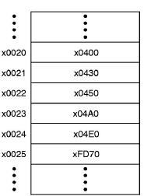
LC-3 TRAP Routines
  GETC (TRAP x20)
    Read a single character from KBD.
    Write ASCII code to R0[7:0], clear R0[15:8].
  OUT (TRAP x21)
    Write R0[7:0] to the monitor.
  PUTS (TRAP x22)
    Write a string to monitor (address of first character of string is in R0).
  IN (TRAP x23)
    Print a prompt to the monitor and read a single character from KBD.
    Write ASCII code to R0[7:0], clear R0[15:8], echo character to the monitor.
  HALT (TRAP x25)
    Print message to monitor & halt execution.
Trap vector table

Slide 5
TRAP Instructions
TRAP: A special instruction
  A form of subroutine call used to invoke a service routine.
  If privilege is being enforced, it switches the execution to privileged mode, and reverts back to user mode when the
  TSR completes.
    R7 ← (PC) ; the current PC is stored in R7
    PC ← Mem[ Zext( IR[7:0] ) ] ; the 8-bit trap vector is loaded to the PC
RET – return instruction
  The TSR ends with the RET instruction
    PC ← (R7) ; the program now picks up where it left off
15 14 13 12
11 10 9 8
7 6 5 4 3 2 1 0
1 1 1 1
0 0 0 0
trapvector8

Slide 6
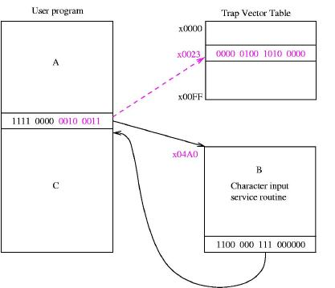
TRAP Example
Trap Vector Table
  Or System Control BLock
  In LC-3
    8 bits specify one of 256 locations (x0000 to x00FF)
    The location contains the address of the TRAP service routine.
TRAP & Interrupts
  Similar mechanisms
  A TRAP is an instruction (event internal to a program).
  An interrupt is external to a program (from an I/O device)
  Both invoke a supervisor service routine.

Slide 7
Character Output TSR (OUT)
01 .ORIG X0430 ; System call starting address
02 ST R1, SaveR1 ; R1 will be used for polling
03
04 ; Write the character
05 TryWrite LDI R1, DSR ; Get status
06 BRzp TryWrite ; bit 15 = 1 => display ready
07 WriteIt STI R0, DDR ; Write character in R0
08
09 ; Return from TRAP
0A Return LD R1, SaveR1 ; Restore registers
0B RET ; Return (actually JMP R7)
0C DSR .FILL xFE04 ; display status register
0D DDR .FILL xFE06 ; display data register
0E SaveR1 .BLKW 1
0F .END

Slide 8
HALT TSR
Clears the RUN latch MCR[15]:
01 .ORIG XFD70 ; System call starting address
02 ST R0, SaveR0 ; Saves registers affected
03 ST R1, SaveR1 ; by routine
04 ST R7, SaveR7 ;
05
06 ; Print message that machine is halting
07 LD R0, ASCIINewLine
08 TRAP x21 ; Set cursor to new line
09 LEA R0, Message ; Get start of message
0A TRAP x22 ; and write it to monitor
0B LD R0, ASCIINewLine
0C TRAP x21
0D
0E ; Clear MCR[15] to stop the clock
0F LDI R1, MCR ; Load MC register to R1
10 LD R0, MASK ; MASK = x7FFF (i.e. bit 15 = 0)
11 AND R0, R1, R0 ; Clear bit 15 of copy of MCR
12 STI R0, MCR ; and load it back to MCR

Slide 9
HALT TSR ( cont.)
13 ; Return from the HALT routine
14 ; (how can this ever happen, if the clock is stopped on line 12??)
15 ;
16 LD R7, SaveR7 ; Restores registers
17 LD R1, SaveR1 ; before returning
18 LD R0, SaveR0
19 RET ; JMP R7
1A
1B ; constants
1C ASCIINewLine .FILL x000A
1D SaveR0 .BLKW 1
1E SaveR1 .BLKW 1
1F SaveR7 .BLKW 1
20 Message .STRINGZ “Halting the machine”
21 MCR .FILL xFFFE
22 MASK .FILL x7FFF
23 .END

Slide 10
Saving & restoring registers
Protect your values!
  Any subroutine call may change values currently stored in a register.
  Sometimes the calling program (“caller”) knows what needs to be protected, so it saves the endangered register before calling the subroutine.
    e.g. in the HALT routine, which has itself been called by another program, the caller knows that it has precious cargo in R7, which will be overwritten by the TRAP instructions (why??), so it saves R7 to memory at the start of the routine, and restores it from memory before returning to the main program.
    This is known as “caller save”

Slide 11
Saving & restoring registers (cont.)
  Other times it will be the called program (“callee”) that knows what registers it will be using to carry out its task.
    again in the HALT routine, R0 and R1 are used as temporary working space to hold addresses, masks, ASCII values, etc., so they are both saved to memory at the start of the routine, and restored from memory before returning to the main program.
    This is known as “callee save”
  This applies not only to trap service routines but to all subroutine calls, and is the basis of what are called “scope rules” in higher level languages.

Slide 12
Subroutines
Used for
  Frequently executed code segments
  Library routines
  Team-developed systems
    in other words, all the same reasons for using subroutines in higher level languages, where they may be called functions, procedures, methods, etc.
Requirements:
  Pass parameters and return values, via registers or memory.
  Call from any point & return control to the same point.

Slide 13
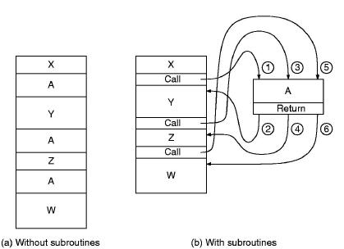
The Call / Return mechanism
  The figure illustrates the execution of a program comprising
  code fragments A, W, X, Y and Z.
    Note that fragment A is repeated several times, and so is
    well suited for packaging as a subroutine:

Slide 14
Jump to Subroutine : JSR/JSRR
JSR: jump to subroutine (PC-Relative)
  A = IR[11] specifies the addressing mode
  JSR: IR[11] = 1:
    R7 ← (PC) i.e. PC is saved to R7
    PC ← (PC) + Sext( IR[10:0] )
    i.e PC-Relative addressing, using 11 bits => label can be within
    +1024 / -1023 lines of JSR instruction
15 14 13 12
11 10 9
8 7 6 5 4 3 2 1 0
0 1 0 0
1
Address eval. bits
JSR(R)
A

Slide 15
JSR/JSRR (cont.)
JSRR: jump to subroutine (Base+Offset)
  JSRR: IR[11] = 0:
    R7 ← (PC) i.e. PC is saved to R7
    PC ← (BaseR)
    i.e Base+Offset addressing, with offset = 0
  In both cases, the RET instruction restores the PC from R7,
  and the calling program resumes.
15 14 13 12
11 10 9
8 7 6 5 4 3 2 1 0
0 1 0 0
0
0 0
BaseR
0 0 0 0 0 0
JSR(R)
A

Slide 16
Subroutine call example
; Calling program
.ORIG x3000
LD R1, num1
LD R2, num2
JSR multi
ST R3, prod
HALT
;
; Input data & result
num1 .FILL x0006
num2 .FILL x0003
prod .BLKW 1
; Subroutine multi
; Multiply 2 positive numbers
; Parameters:
; In: R1, R2; Out: R3
;
multi AND R3, R3, #0
ADD R4, R1, #0
BRz zero
loop ADD R3, R2, R3
ADD R1, R1, # -1
BRp loop
zero RET
.END

Slide 17
Library Routines
Library
  A set of routines for a specific domain application.
  Example: math, graphics, GUI, etc.
  Defined outside a program.
Library routine invocation
  Labels for the routines are defined as external. In LC-3:
    .External Label
  Each library routine contains its own symbol table.
  A linker resolves the external addresses before creating the executable image.

Slide 18
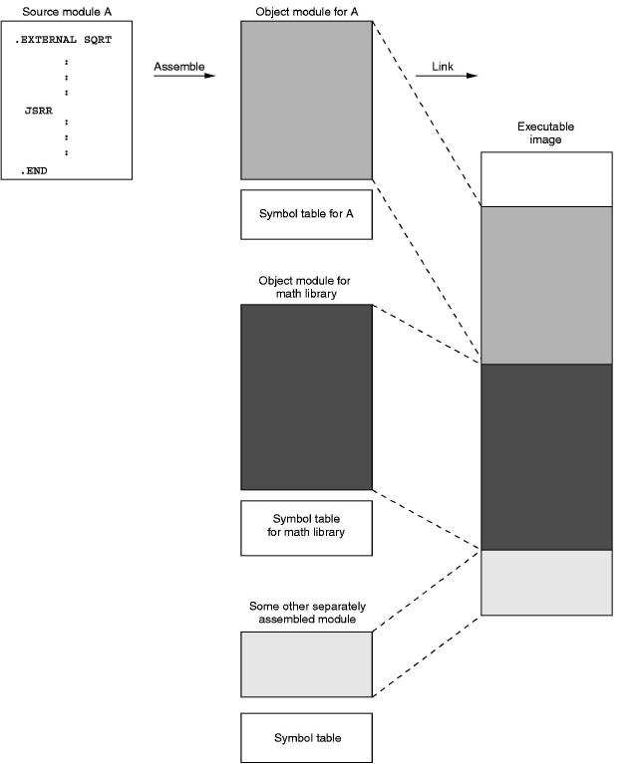
Linking multiple files

